Slide 1
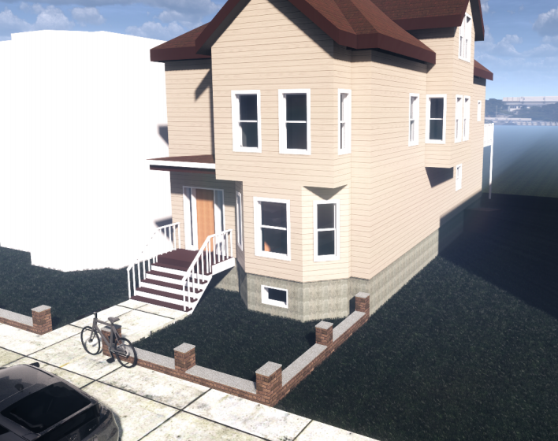
68 Horace St
Neighborhood Association Meeting
Monday, August 2nd, 2021

Slide 2

About the Owners
Homeowners: Whitney Zelee & Allison Cahill
Purchased 68 Horace in December; Moved into Unit 2 in March
Rented in Jeffries Point for 10 years prior to 2017
Work in the Downtown Boston area
Love being in Harbor View!
Fun Fact: We play professional women’s football! Home games are at Harry Della Russo Stadium in Revere

Slide 3
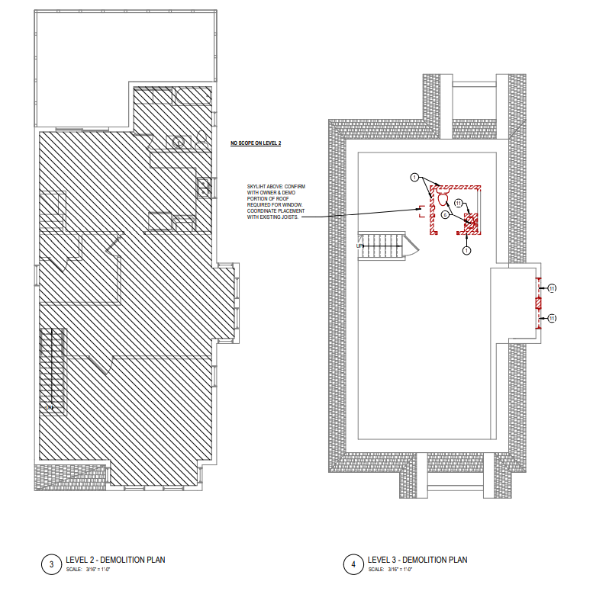
68 Horace-Unit 2 Existing Layout & Function
2-bedroom, 1 bath layout
Existing half bath in the attic
No permit history for bathroom
2nd bedroom being used as office space so the house functions as a 1 bedroom

Slide 4
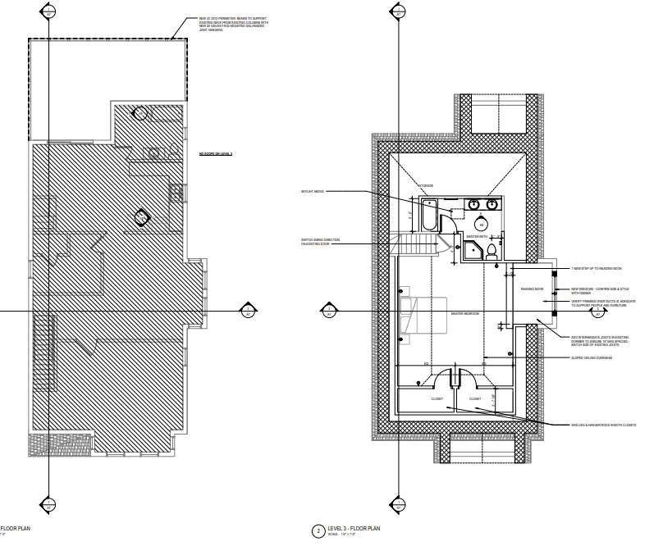
68 Horace-Unit 2 Desired Layout & Function
Increase ½ bath to full and bring up to code
Add additional bedroom/master suite
More room to grow into and better serve our long-term needs
No changes to the structure or footprint

Slide 5
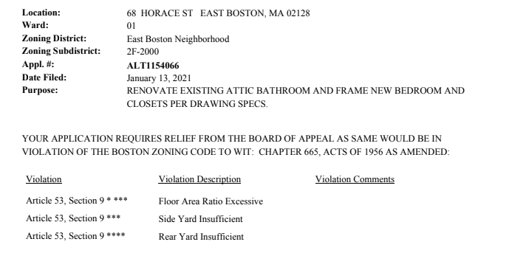
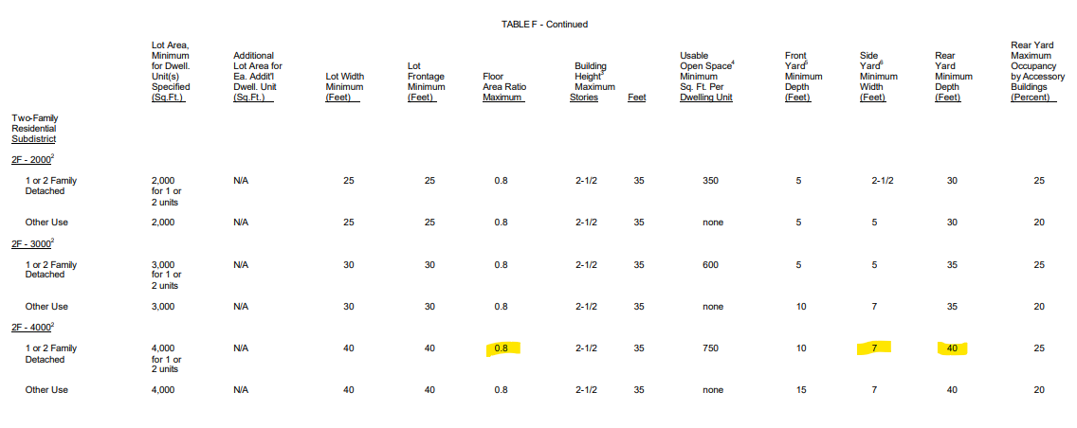
68 Horace-Zoning Violation
Floor Area to lot size can not exceed a ratio of 0.8
Side Yard must be a minimum of 7 ft
Rear Yard must be a minimum of 40 ft

Slide 6
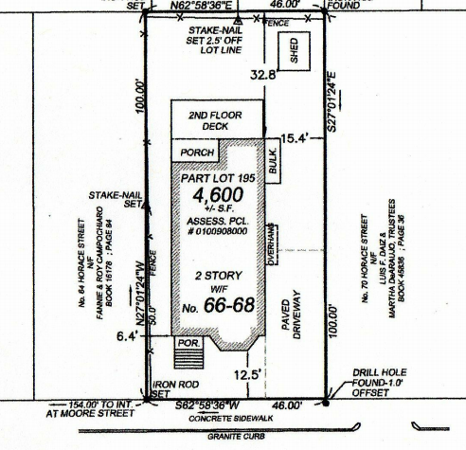
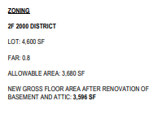
Side yard and rear yard violations are pre-existing and are not the result of the work we are proposing to do
FAR of 0.8 would allow for 3680 SF of livable space and if we were to finish both the basement and attic, we would only be at 3596 SF. Attic alone is well below FAR limit

