Slide 1
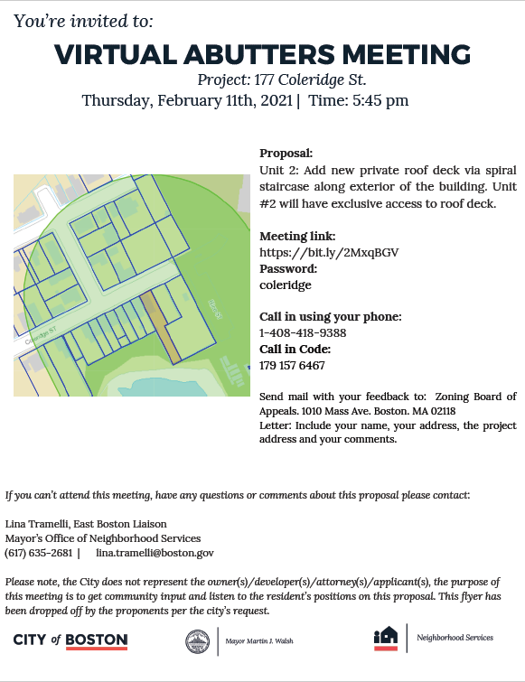
177 Coleridge St.
East Boston, MA 02128
Dipierro construction

Slide 2
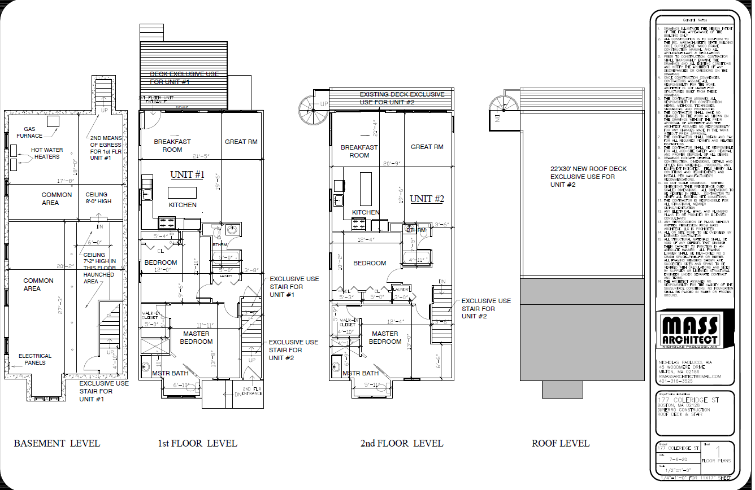
Floor Plans

Slide 3
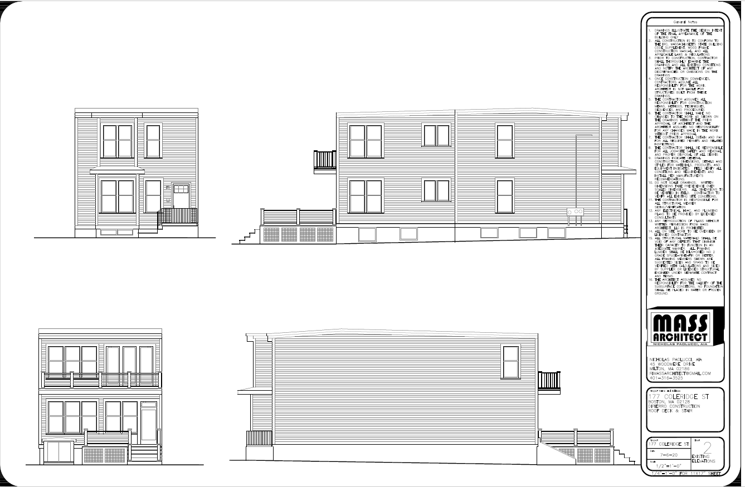
Existing Elevations

Slide 4
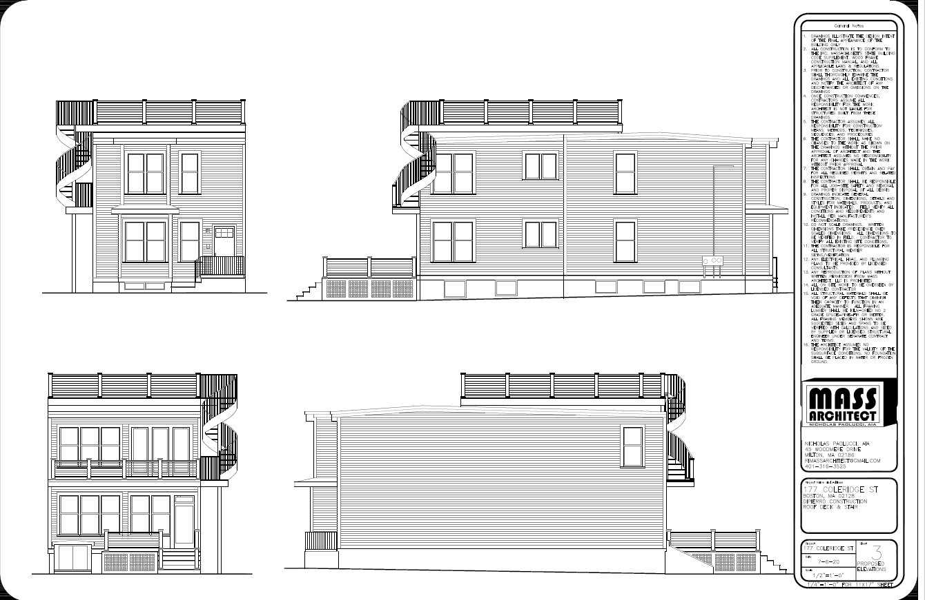
Proposed Elevations

Slide 5
Deck Framing & Details

Slide 6
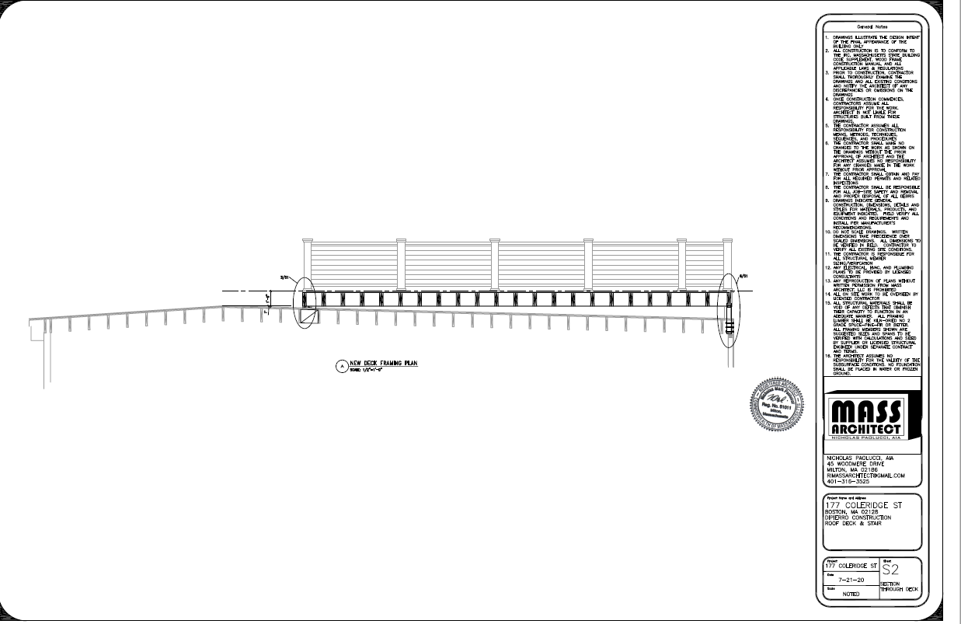
Section Through Deck

